Slide 1
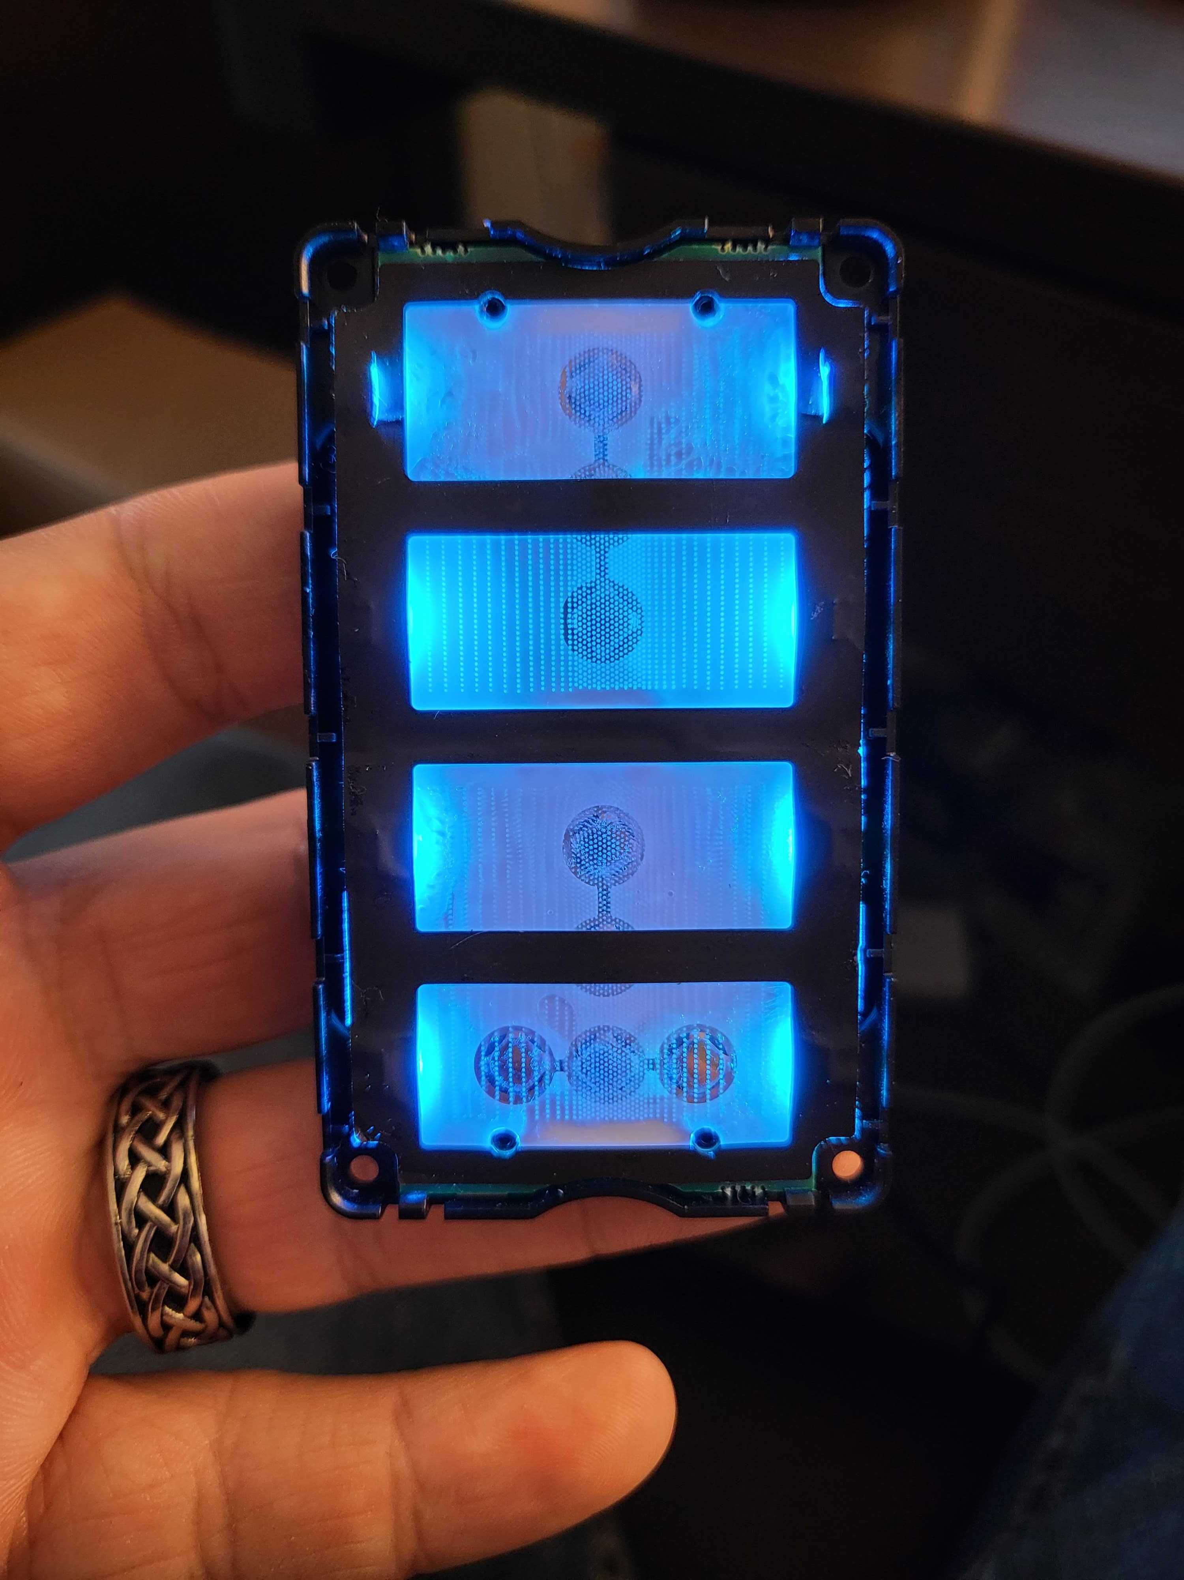
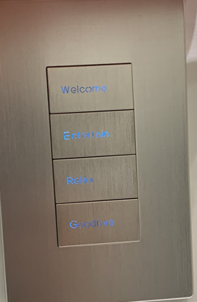
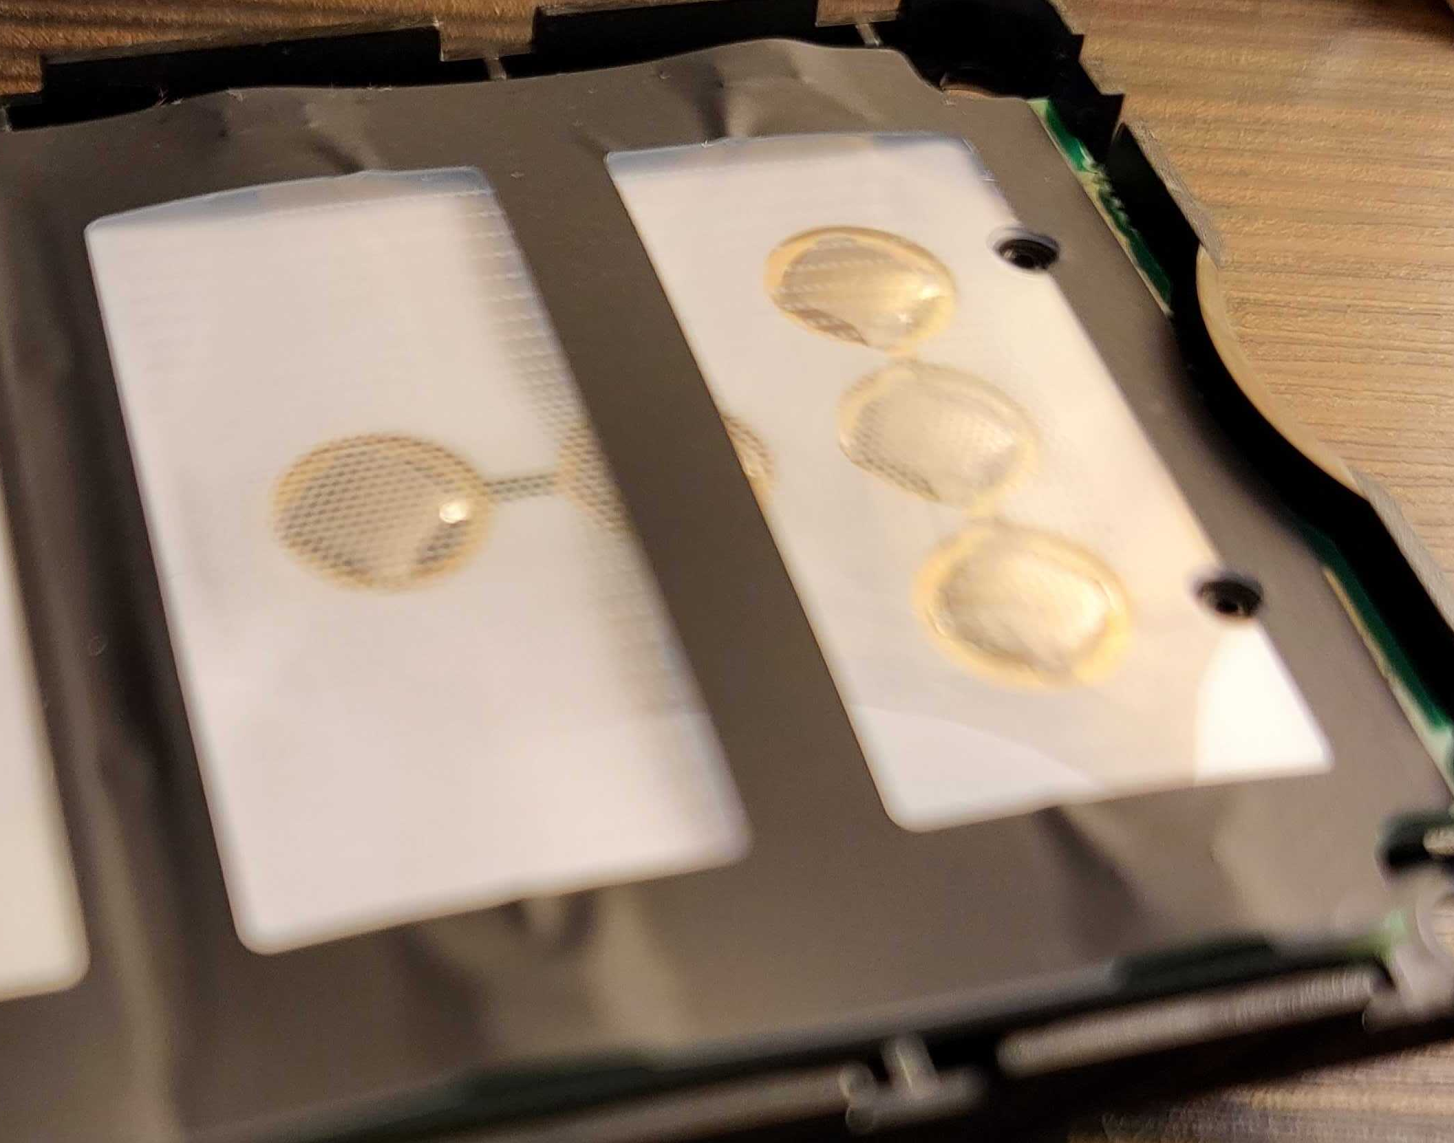
Unevenness is caused by a gap between the lightguide and button pad. Light is being reflected closer to the LED causing bright edges and dimness in the middle of the button.

Slide 2
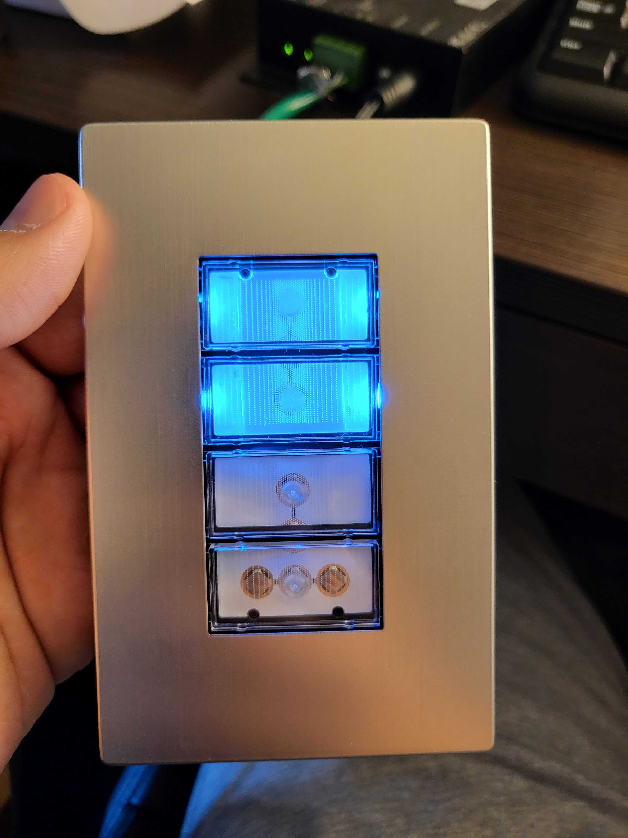
Adhesive under the lightguide worsens the unevenness. The image on the left uses superglue and leaves a streaky pattern. The image on the right uses double-sided tape which leaves a more consistent but still obvious mark.
Adhesive can still be applied under the lightguide, but it must be consistent over the whole light guide

Slide 3
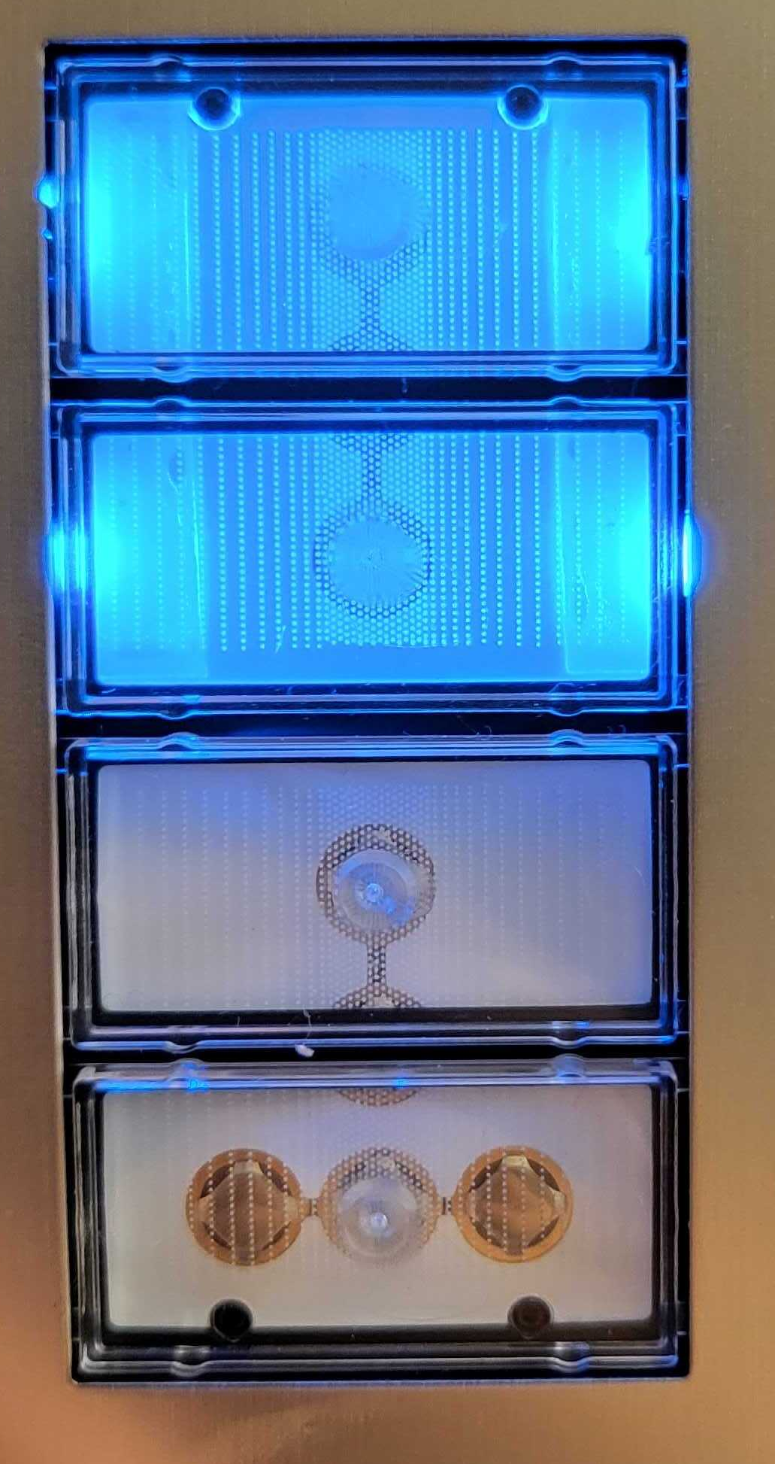
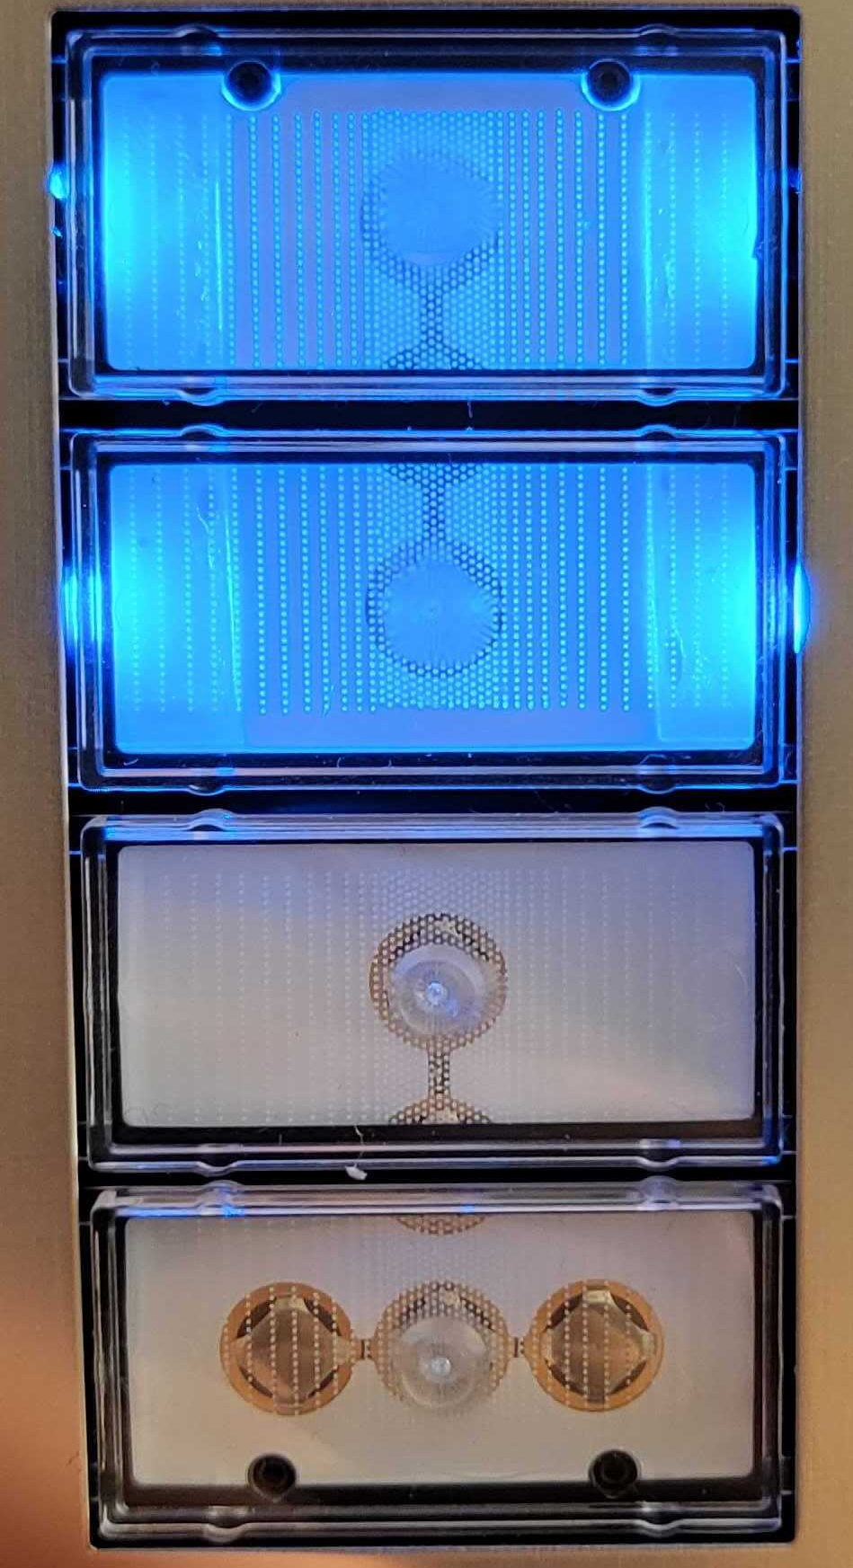
Dimming the LEDs seems to make the inconsistency less noticeable, but with a diffuser it is very dim

Slide 4
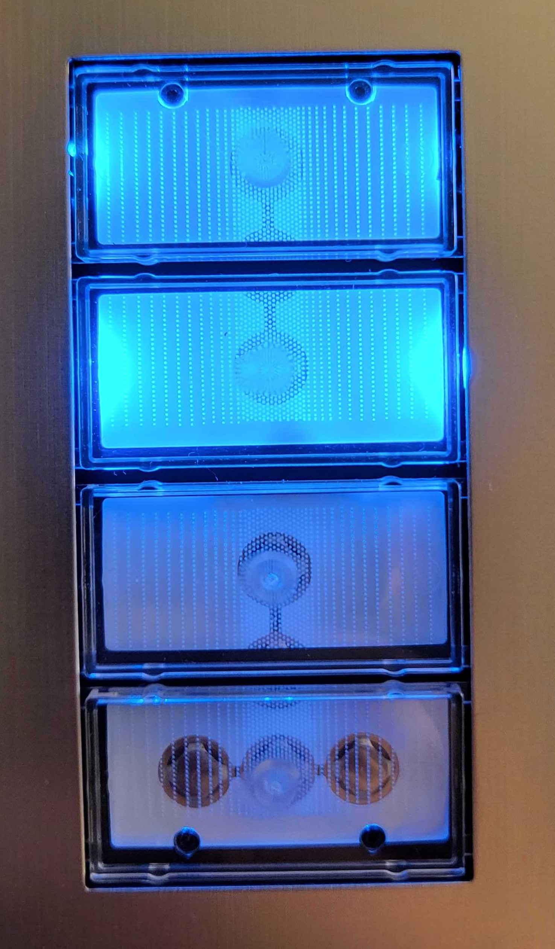
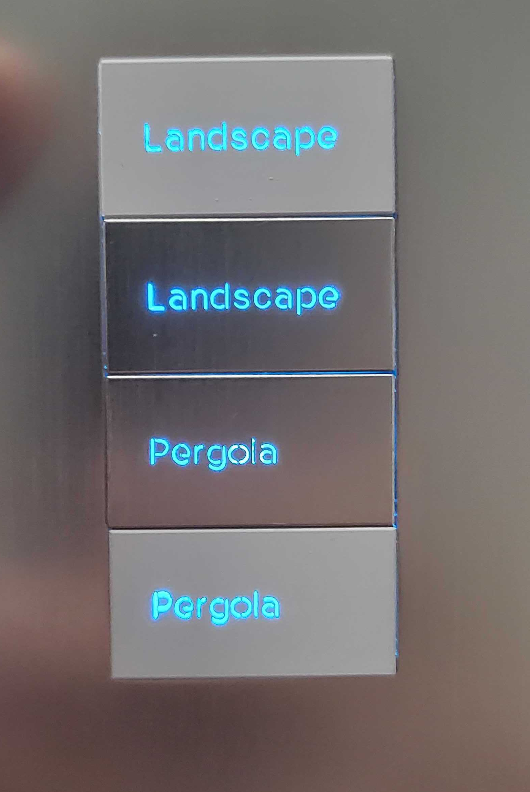
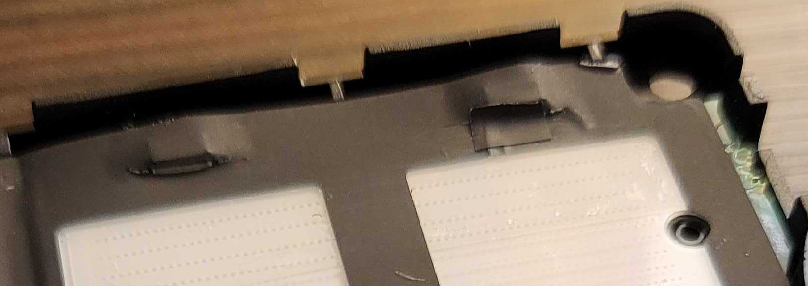
Adding cuts in the mylar tape allows the mylar directly adjacent to the lightguide to lay flat on the button pad, but also allows light to leak over the top of the light guide. This light can be blocked with additional mylar.
The middle image shows the difference in light consistency when the cuts are covered vs when they're not (top button and bottom respectively). The right image shows the same keypad with buttons, notice the evenness of the first button compared to the second (the bottom two are unmodified).

Slide 5
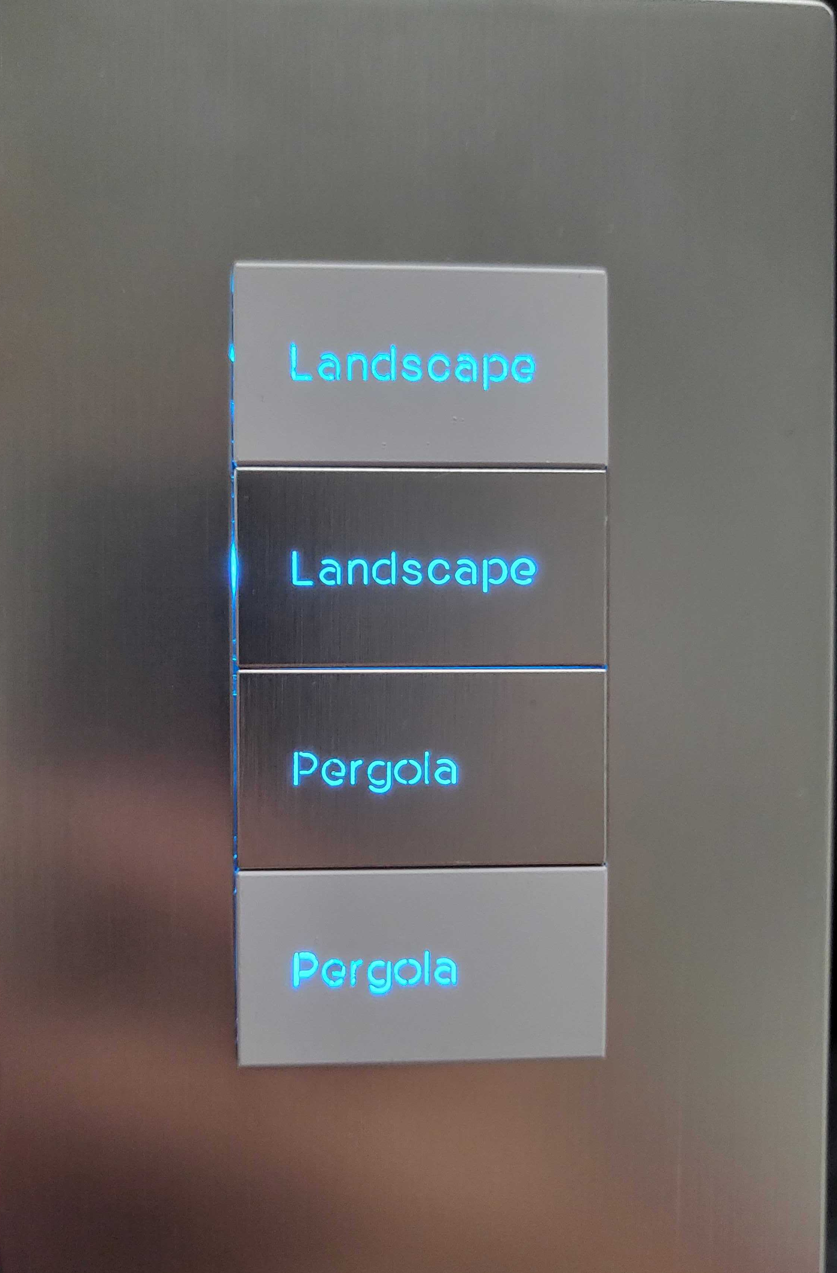
Not covering the cut results in another issue where light escapes through the side of the button, shown in these images.

Slide 6
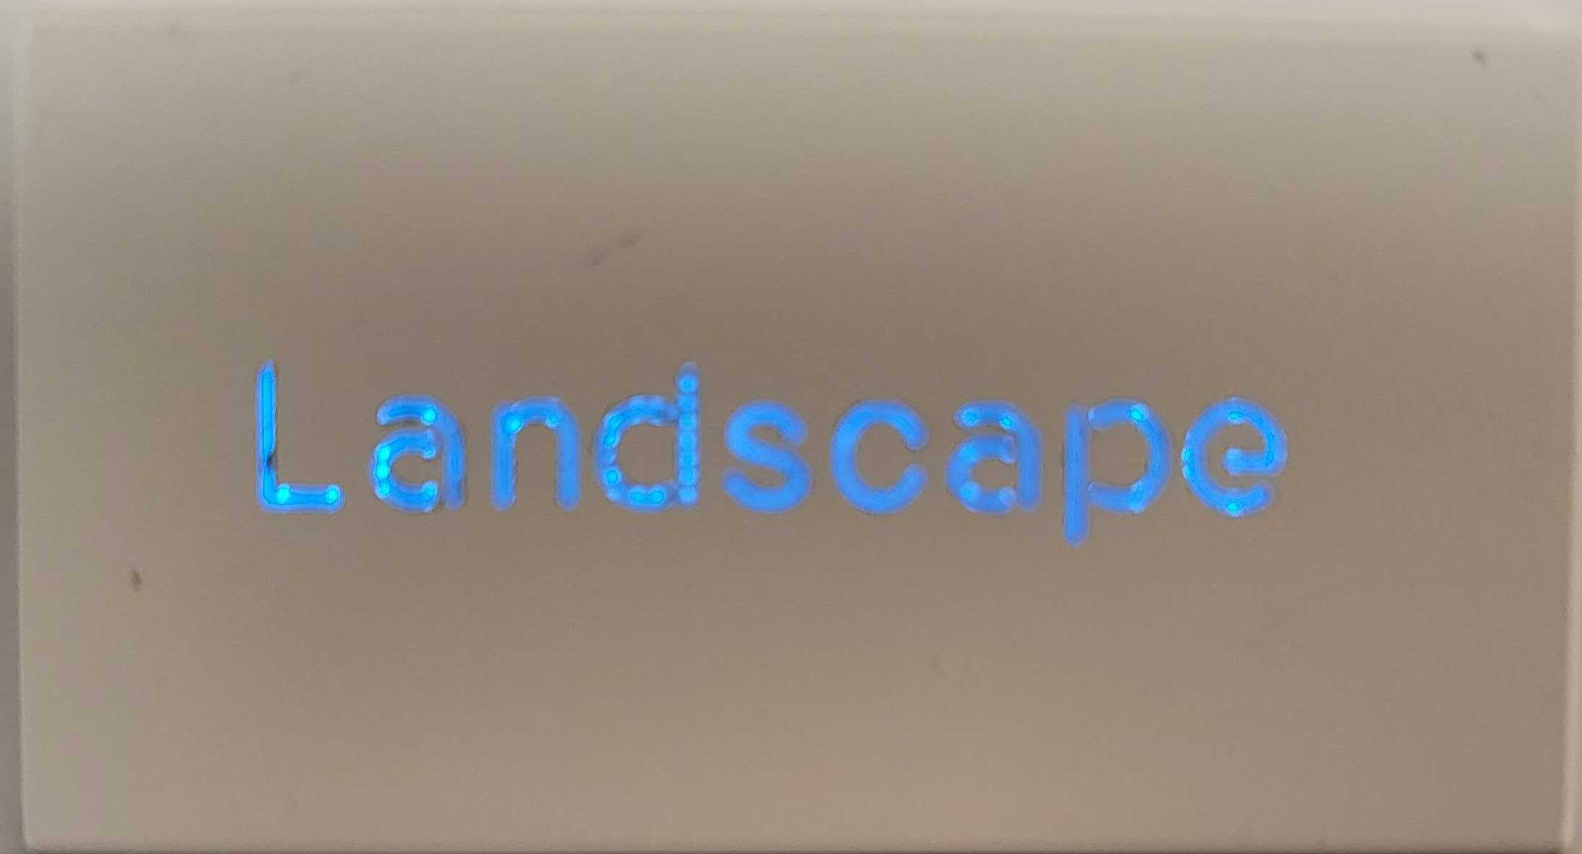
Here are some pictures from an experiment with blocking the light via a 3D printed shield. This experiment yielded a more even backlight but with the addition of a diffuser, the device was quite dim. (the two images of the buttons are with and without the diffuser, top and bottom respectively)

Slide 7
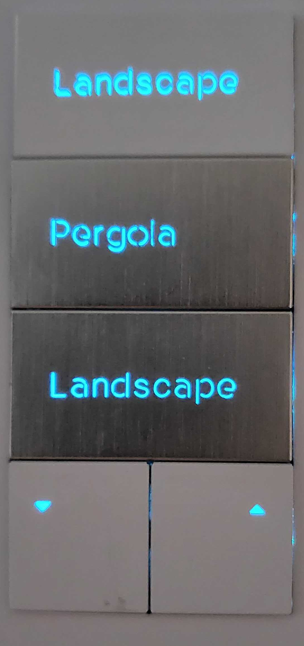
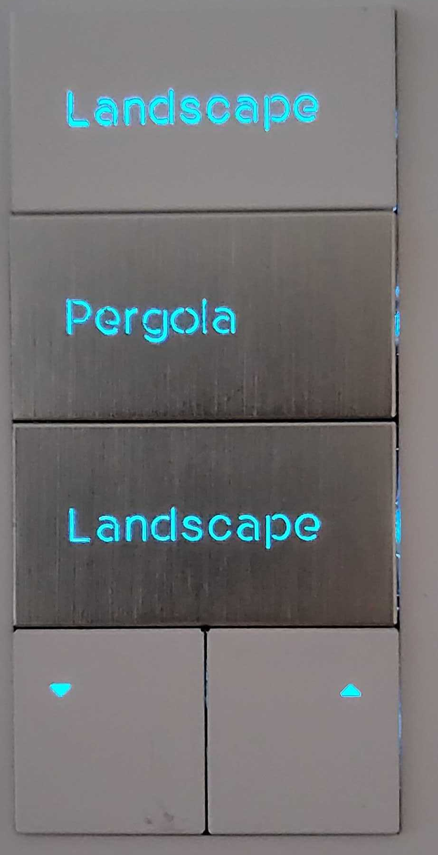
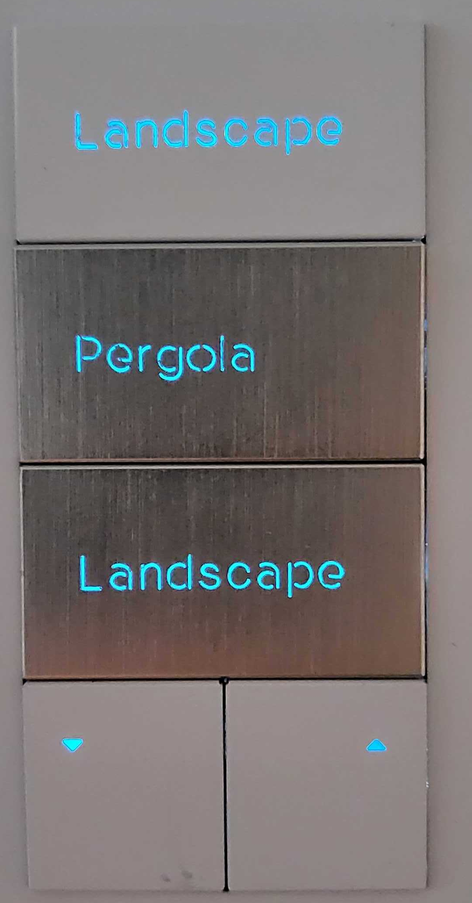
Images of the test from the last slide at different brightness's (High to low from left to right, last image is lowest brightness in a well-lit room)

Slide 8
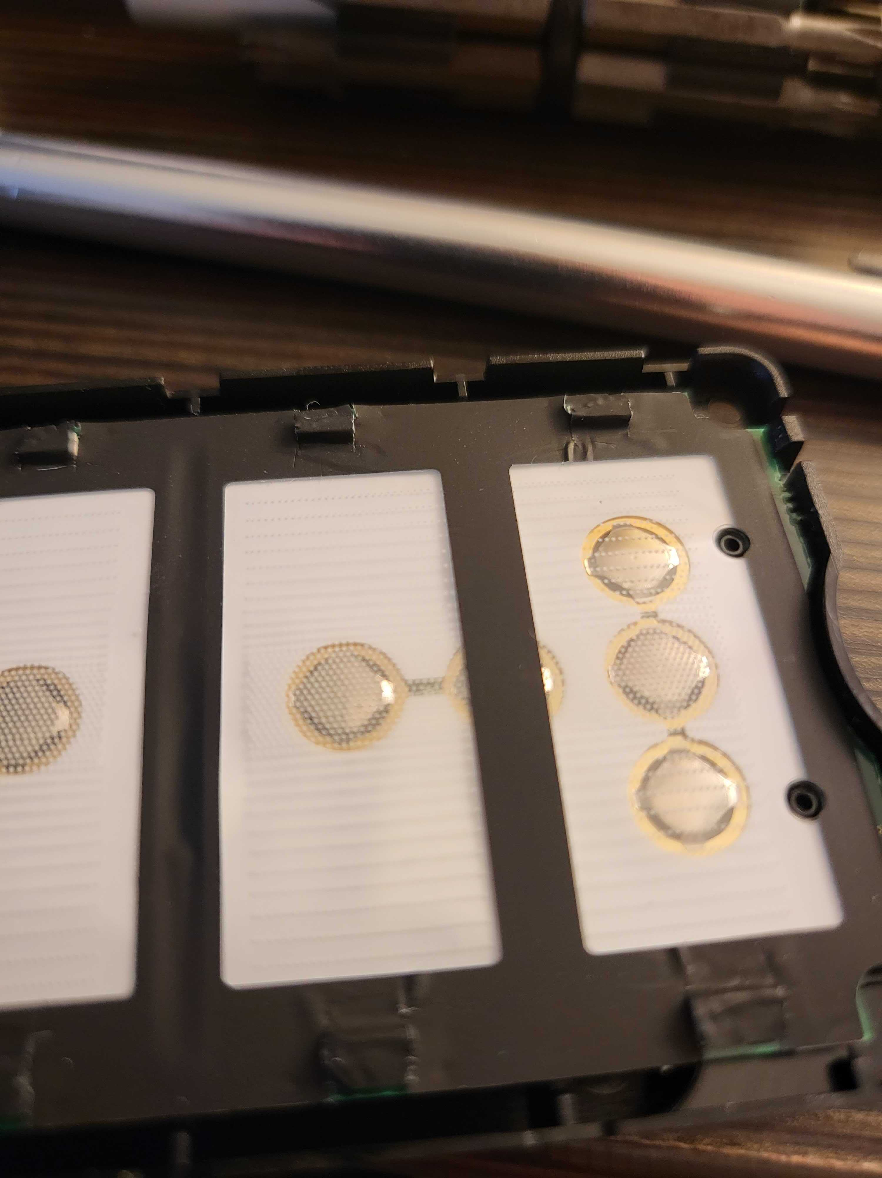
In the final test, cuts were made along the edges of the LED and the mylar was pressed up against the lamp. The mylar keeps the lightguide flat and blocks light from escaping undesirably

Slide 9
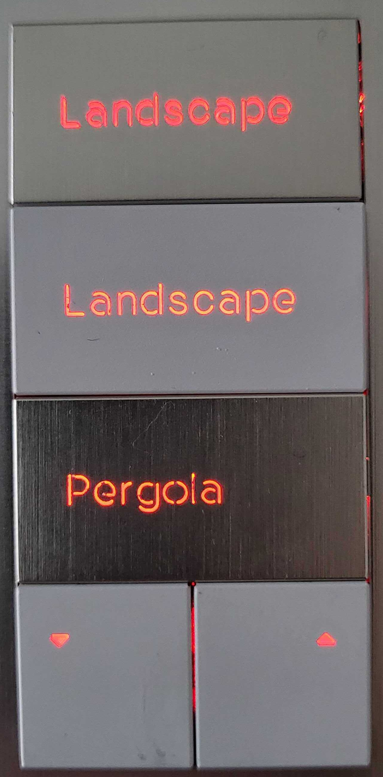
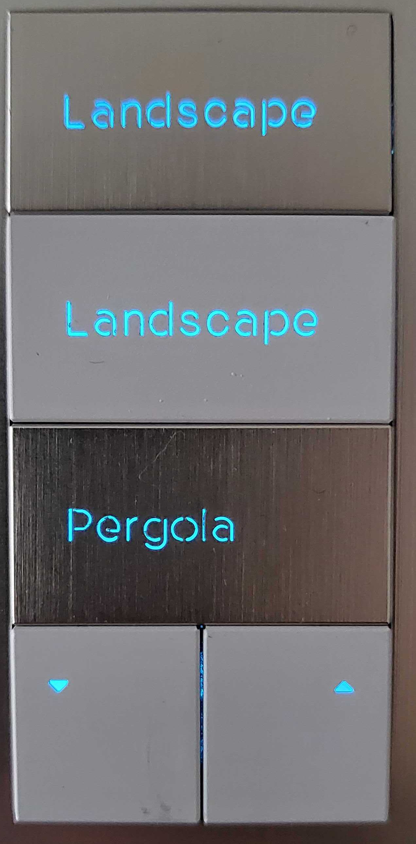
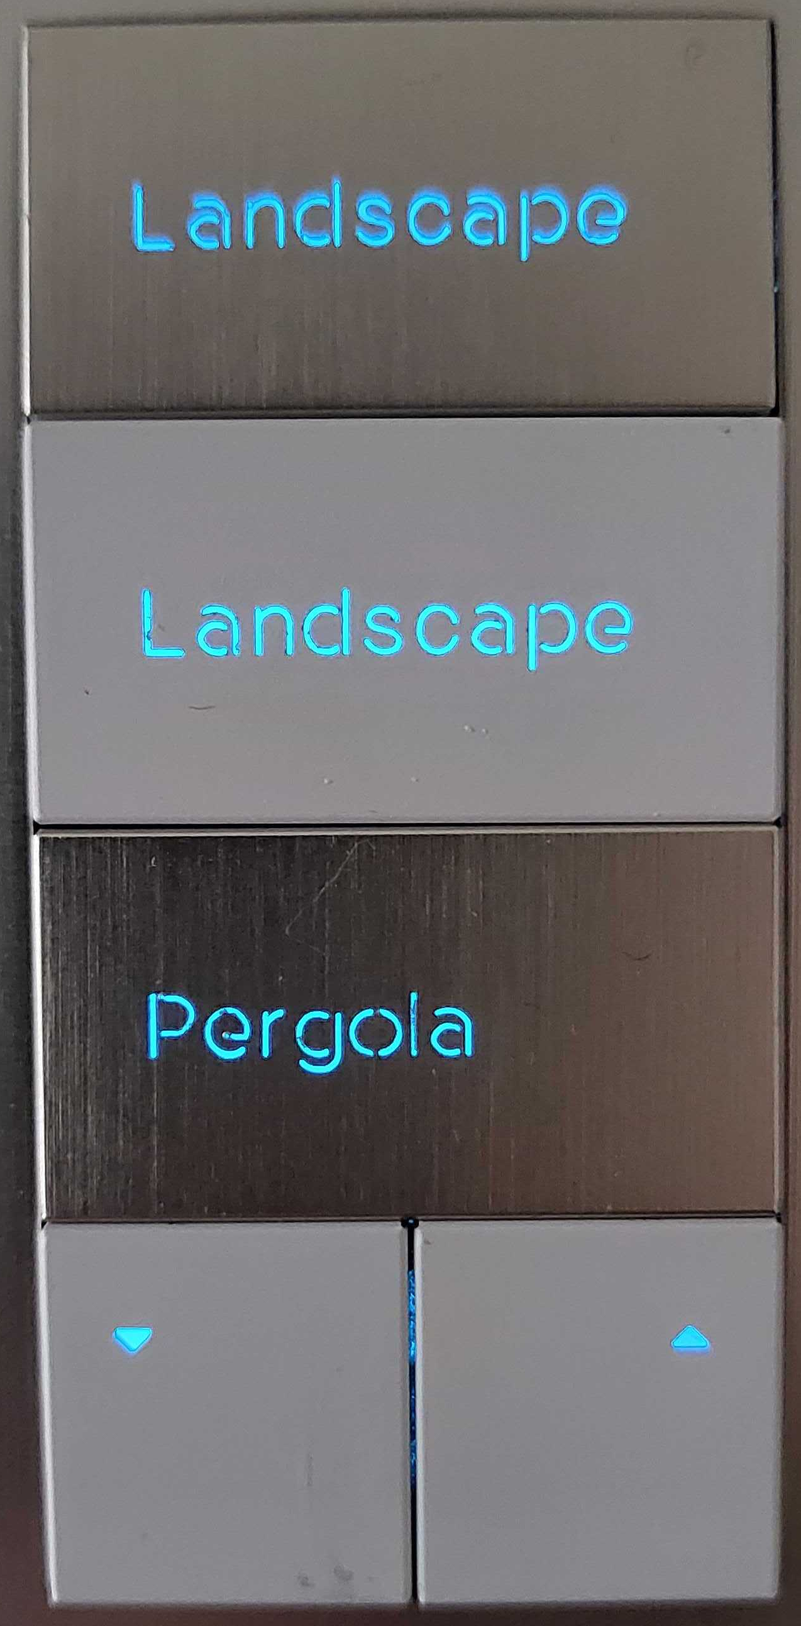
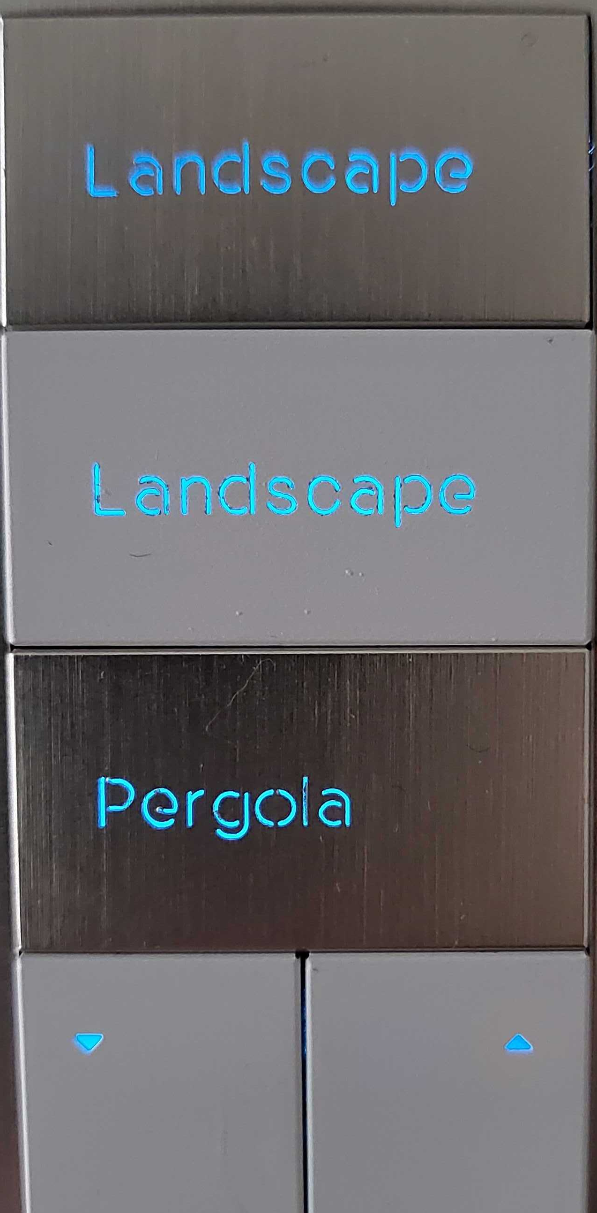
The first three from the left are pure red green and blue at max brightness, the remaining blue keypads show half brightness and min brightness from left to right respectively
Note the light leaking through the sides of the keypad in the first two images are from small cuts in the mylar made accidentally when it was pressed up to the LED and to not accurately reflect it’s light blocking ability.

Slide 10
Additional Notes
Sanding the lightguide to make a rougher surface has little to no effect on brightness when a diffuser is used
Diffusers lower the brightness but add much more evenness
Using a thicker lightguide may allow more light to enter and make the backlighting brighter. This is a theory based on research but is untested because a new lightguide would need to be made.
The non-white areas of the button pad contribute to a dimmer middle section of the backlighting because they absorb light from the LEDs.

