Slide 1
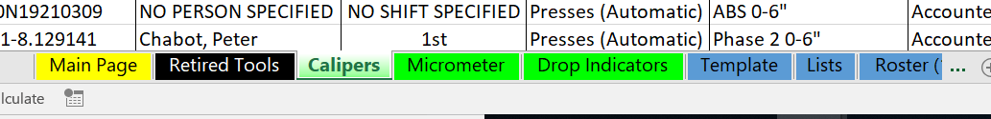
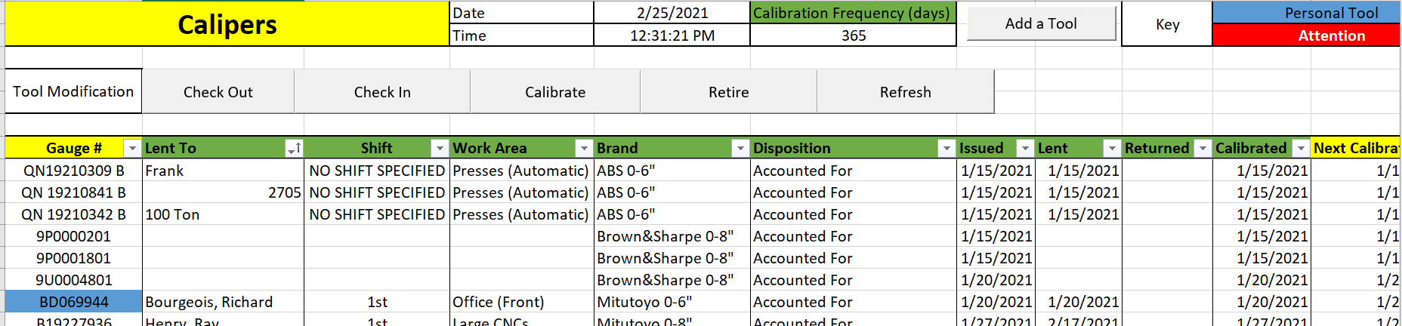
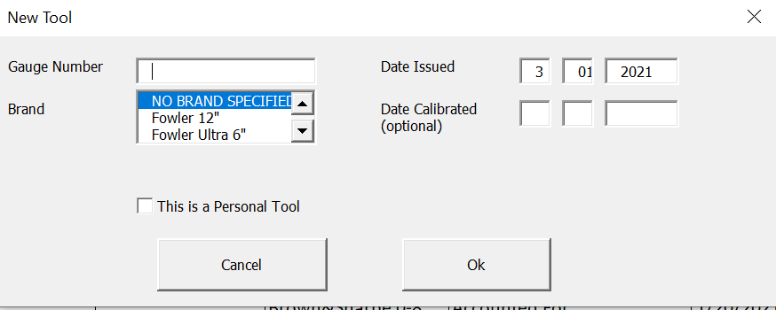
Work Instructions
ABB Electrification Products Industrial Solutions, Auburn, ME |  |  |  |  | Type of instruction: Calibration
 |  |  |  |  | Product Line: QC Calibration Master File |  | Rev: 1
 | Quality check |  |  | Verify | Task: Registering A tool |  | Page: 1 OF 4
 | Operation |  |  | EHS | Issued by: Jacob Willette | Approved by:
 |  | In the QC Calibration Master File, select the sheet with the proper tool name Click “Add Tool” and enter gauge number, brand, date issued, and optionally, the date it was calibrated If the tool being entered was not owned by the plant, check the “Personal Tool” box Click ok, and the tool will be added to the database but is NOT ready to be lent out. (if the tool it already in the database, it cannot be added twice
 | Safety glasses and safety shoes required at this work station. | Safety glasses and safety shoes required at this work station. | Safety glasses and safety shoes required at this work station. | Safety glasses and safety shoes required at this work station.
1
1
2
2
3
4
3
4

Slide 2
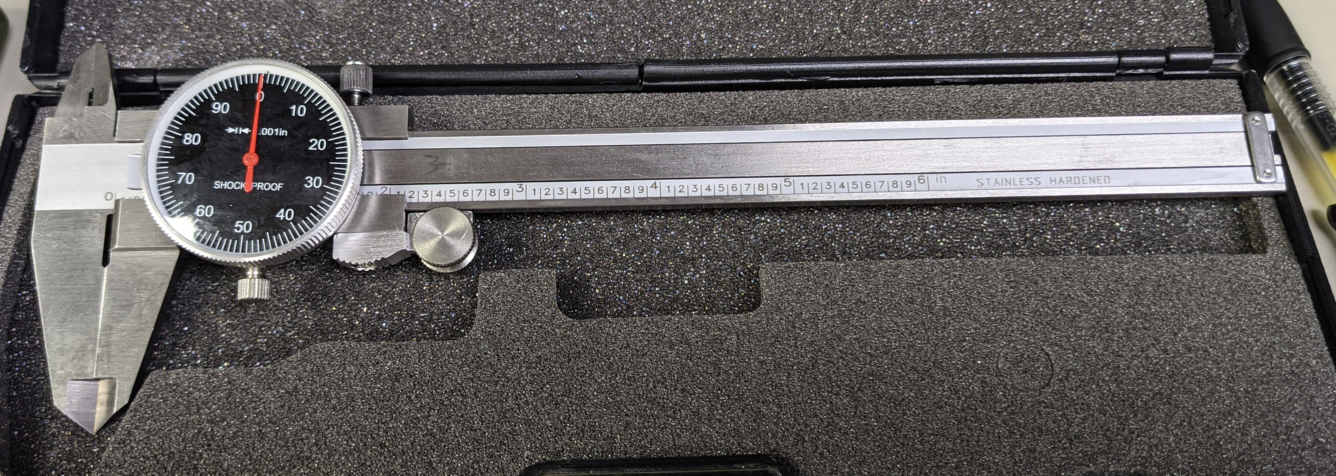
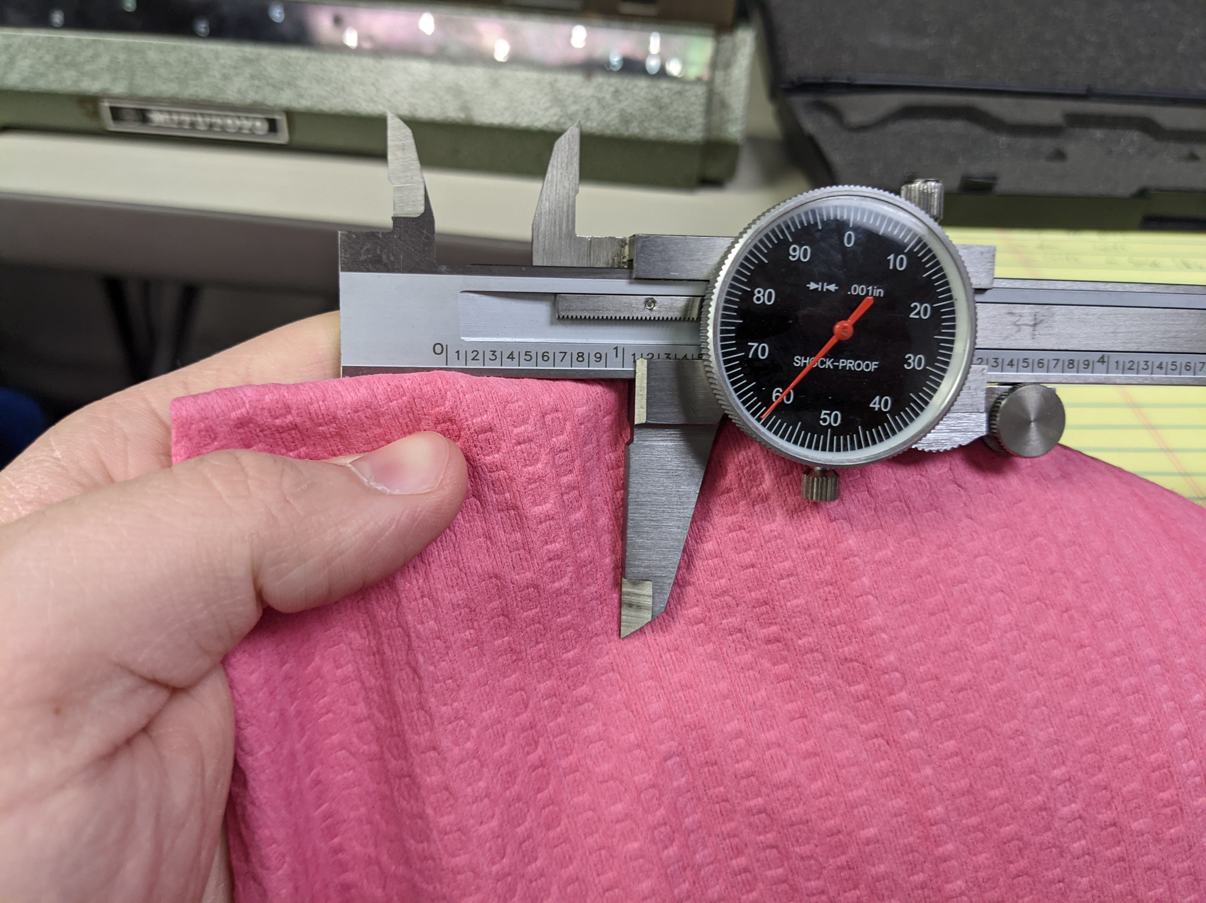
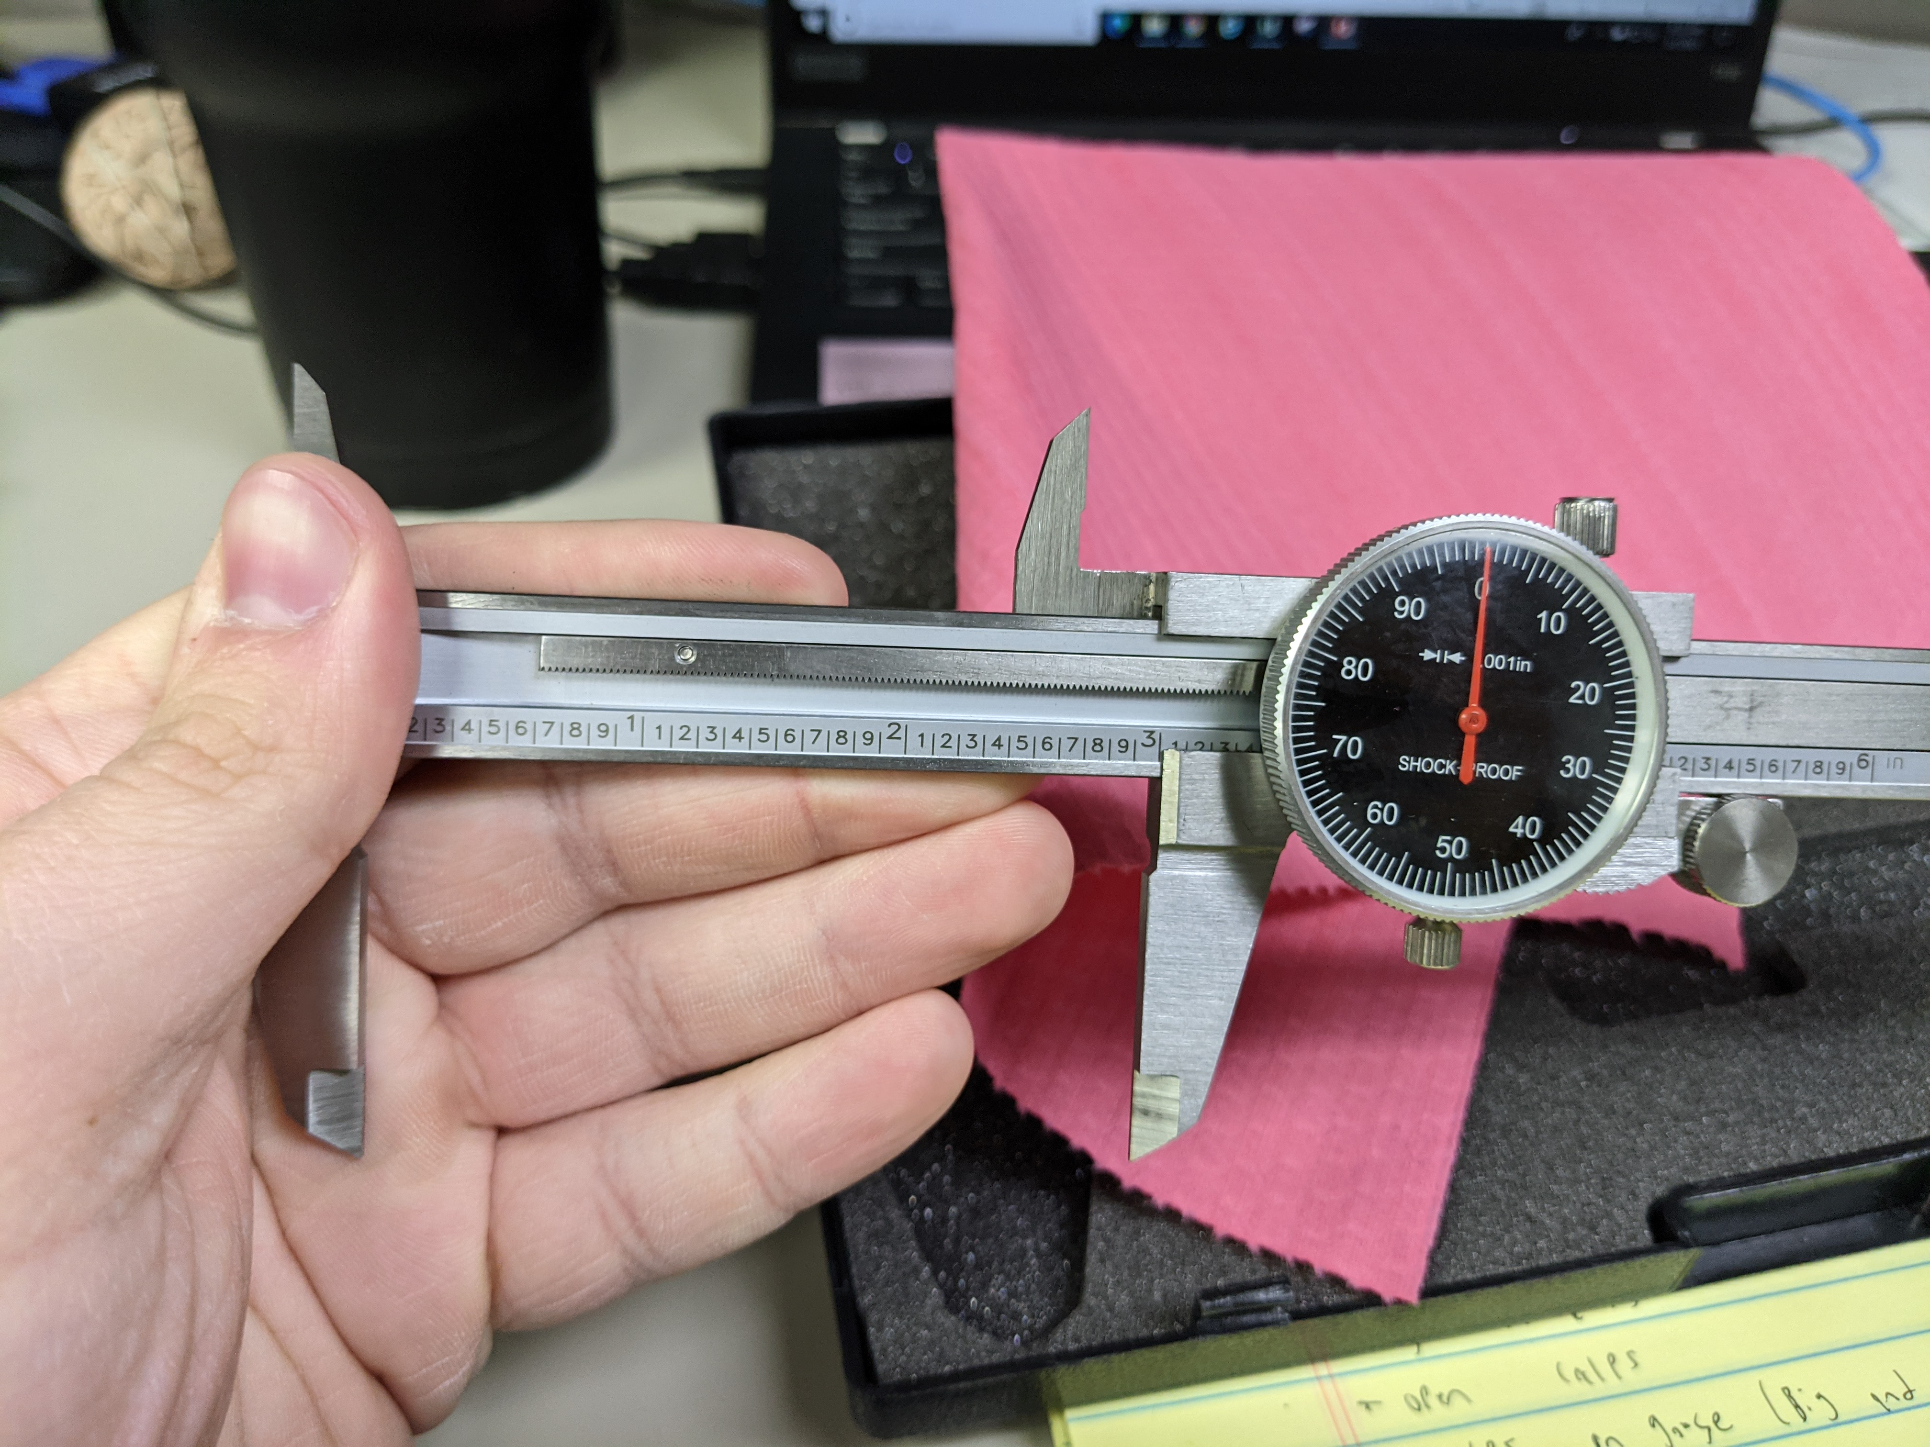
Work Instructions
ABB Electrification Products Industrial Solutions, Auburn, ME |  |  |  |  | Type of instruction: Calibration
 |  |  |  |  | Product Line: Calipers |  | Rev: 1
 | Quality check |  |  | Verify | Task: Inspection |  | Page: 2 OF 4
 | Operation |  |  | EHS | Issued by: Jacob Willette | Approved by:
 |  | Visually inspect the tool and look for any of the following: Bent needles Evidence of dropping Evidence of modification Missing pieces (fastening nobs or stoppers) Dials which are shifted more than 90 degrees Wipe the calipers clean of any residue and zero them in the fully closed position Open and close the tool five times to test if it returns to the same position and if it has a smooth travel
 | Safety glasses and safety shoes required at this work station. | Safety glasses and safety shoes required at this work station. | Safety glasses and safety shoes required at this work station. | Safety glasses and safety shoes required at this work station.
1
1
2
3
2
3

Slide 3
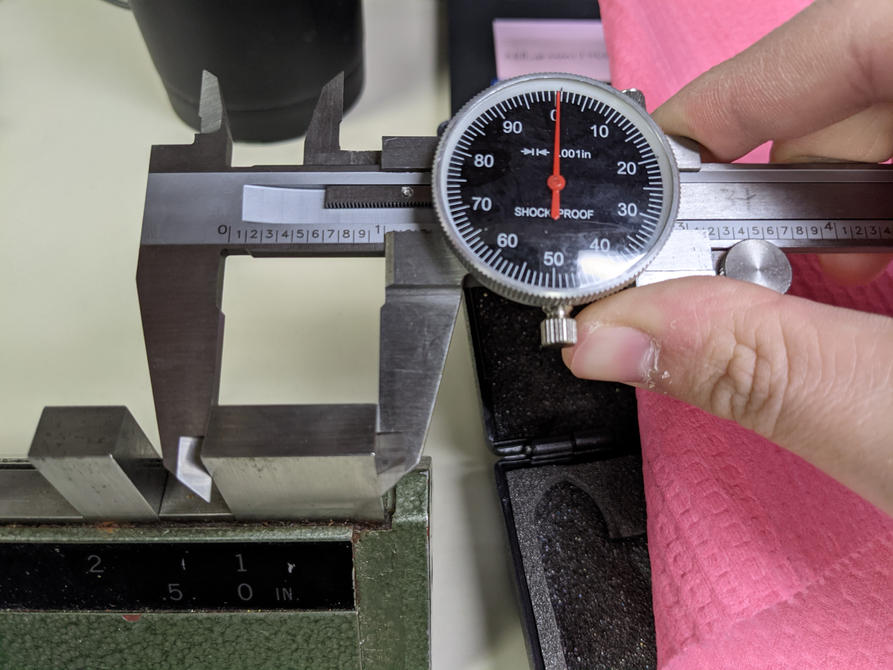
Work Instructions
ABB Electrification Products Industrial Solutions, Auburn, ME |  |  |  |  | Type of instruction: Calibration
 |  |  |  |  | Product Line: Calipers |  | Rev: 1
 | Quality check |  |  | Verify | Task: Inspection |  | Page: 3 OF 4
 | Operation |  |  | EHS | Issued by: Jacob Willette | Approved by:
 |  | Do the following on the 1 inch, 2 inch, and maximum size gauge the calipers can handle: Check the back of the caliper arm’s reading Check the center of the caliper arm’s reading Check the tip of the caliper arm’s reading Check the inner caliper arm’s reading If these readings are within 1 thousandth of an inch, the calipers are acceptable
 | Safety glasses and safety shoes required at this work station. | Safety glasses and safety shoes required at this work station. | Safety glasses and safety shoes required at this work station. | Safety glasses and safety shoes required at this work station.
4
5
6
7
8
4
9

Slide 4
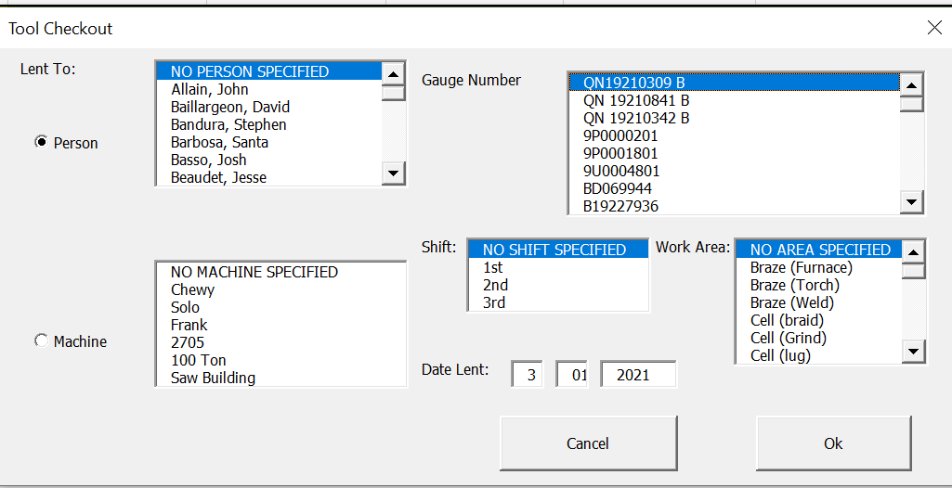
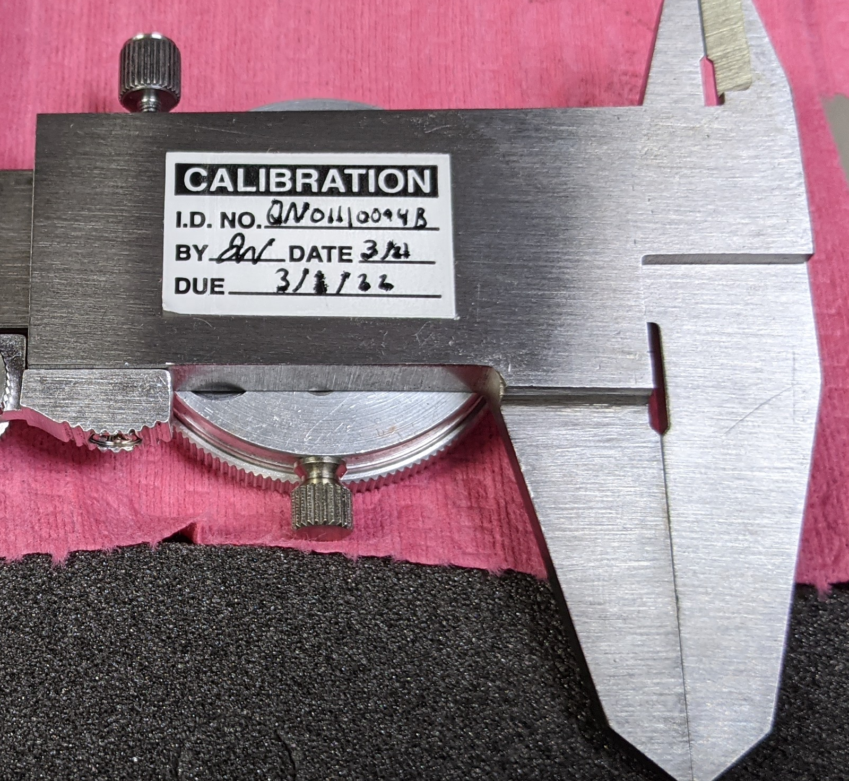
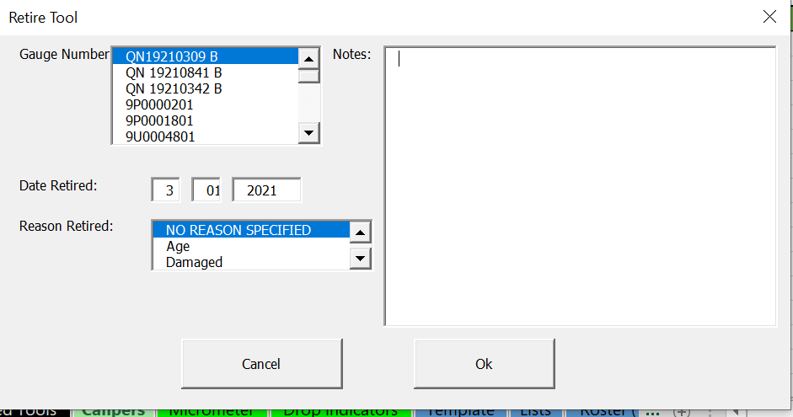
Work Instructions
ABB Electrification Products Industrial Solutions, Auburn, ME |  |  |  |  | Type of instruction: Calibration
 |  |  |  |  | Product Line: QC Calibration Master File |  | Rev: 1
 | Quality check |  |  | Verify | Task: Post Inspection |  | Page: 4 OF 4
 | Operation |  |  | EHS | Issued by: Jacob Willette | Approved by:
 |  | For a passed tool: Fill out and attach a calibration sticker on the back of the tool Check the tool out through the QC Calibration Master File if desired, or store for future use For a failed tool: Retire the tool through the QC Calibration Master File, recover it’s useful parts, and scrap what is left
 | Safety glasses and safety shoes required at this work station. | Safety glasses and safety shoes required at this work station. | Safety glasses and safety shoes required at this work station. | Safety glasses and safety shoes required at this work station.
1A
2A
2A
1A
1B
1B

Slide 5
Work Instructions
ABB Electrification Products Industrial Solutions, Auburn, ME |  |  |  |  | Type of instruction:
 |  |  |  |  | Product Line: |  | Rev: 1
 | Quality check |  |  | Verify | Task: |  | Page: _ OF _
 | Operation |  |  | EHS | Issued by: Jacob Willette | Approved by:
 | Safety glasses and safety shoes required at this work station. | Safety glasses and safety shoes required at this work station. | Safety glasses and safety shoes required at this work station. | Safety glasses and safety shoes required at this work station.
Rev | Date | Description

